Slide 1
How to design a professional presentation

Slide 2
Introduction
Having a PowerPoint presentation that is put together with no attention to
content or visual appeal is like turning up to an interview in a t-shirt and thongs.
A well designed, carefully constructed presentation will support your message,
convey professionalism, and leave your audience with a positive impression of
you and your message.
The first step is to edit your content.
Your presentation should have a logical flow with a structured beginning,
middle and conclusion that is easy to follow and understand.
Keep one idea per slide, with a few essential points explaining it.
No more than six short bullet points per slide is a good rule of thumb.
Your presentation should be a visual aid only – don’t do a word-for-word
narration of your slides.
The following slides contain design tips on how to produce a professional-looking PowerPoint presentation.

Slide 3
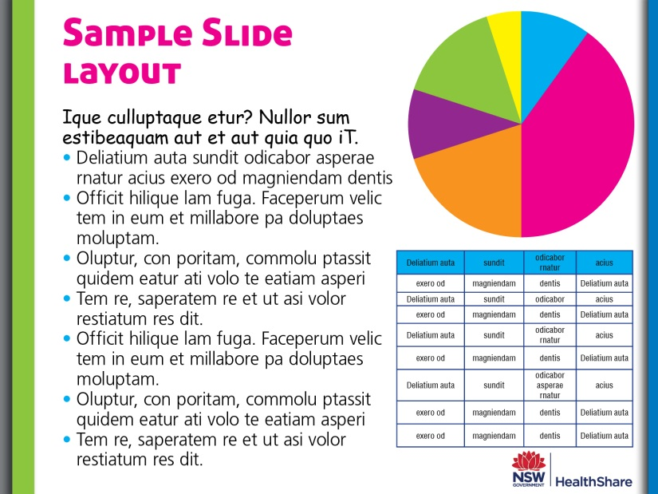
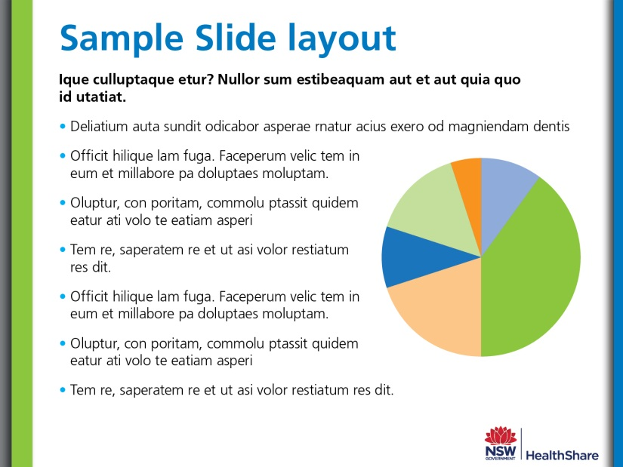
Keep it simple
Your visual presentation design should support your verbal delivery.
For a professional look, limit the colour palette and font types to three at most
(if more colours are needed, use tints). Your slide should have plenty of white space – less clutter makes it easier to read.
NO
YES

Slide 4

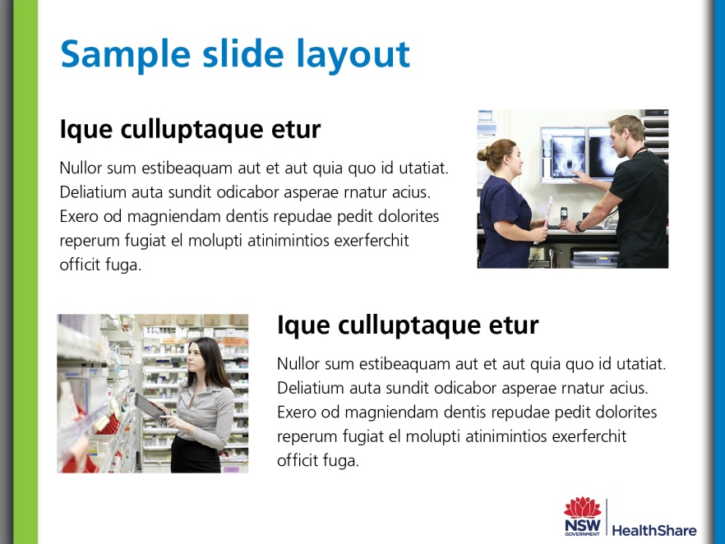
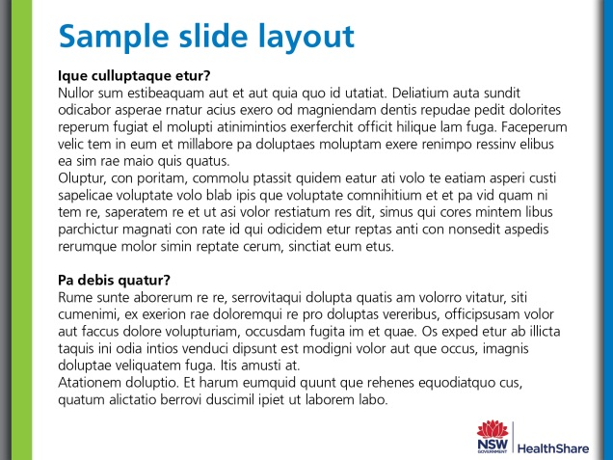
Balance text and images evenly
A presentation is not a report. A slide full of text is boring and hard to read.
Similarly a presentation that is all images looks like a photo album and can provide very little information (unless you are using it as a title or introductory slide).
Images and text should be balanced and not repetitive on the slide and throughout the presentation. Limit the amount of content on each slide, and make sure the images are
relevant to the text.
NO
YES
NO

Slide 5






Avoid cartoonish clipart
Use high quality images or create your own infographic style images and effects with PowerPoint’s Shapes, SmartArt and Chart tools. You can apply effects to photos, but remember to use the same effect for all photos in your presentation.
NO
YES

Slide 6
Creating PowerPoint infographics
You can create the graphics you want by overlapping PowerPoint’s Shapes and SmartArt elements, and applying effects to the graphics, e.g. shadows, bevels. Infographics generally use solid colours and simple shapes, and are normally used to graphically represent data. Fonts such as Zapf Dingbats or Wingdings can also be used to create images. Make sure you group (Ctrl+G) your finished graphic.
Below are examples of infographics.
The orange shapes dynamically show the increase in usage. Increasing font size adds emphasis and creates an impression of growth.
+
+
+
=
2012
Adoption
of mobile technology
use in
hospitals
+
=
2014
70%
+
=
of NSW Health staff can now access their rosters online

Slide 7
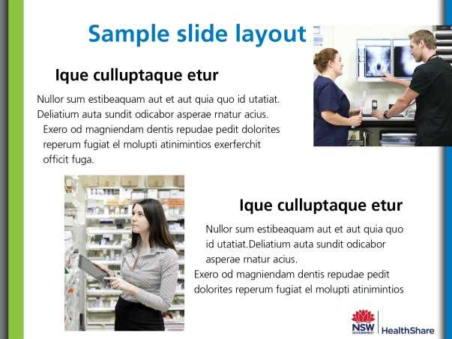

Consistency is key
Use the same font, size and colour for the same element, such as headings. PowerPoint automatically adjusts the font size to fit the text box – instead manually select the text and change it to the same font size you are using throughout the presentation. In the same way, make sure your images are the same size.
Alignment
Make sure all your slide elements are aligned – the human
eye naturally looks for lines, if your paragraphs and images
are out of alignment it looks amateurish.
How to align
objects on a slide
Select all objects by holding down “Shift” and clicking on all of them.
Select “Format” in the top options bar, then choose “Align.”
Select “Align to Slide.”
Select “Format” in the top options bar again, then choose “Align.”
Choose the type of alignment you'd like.
BEFORE
AFTER

Slide 8
Present data visually
Data often has more visual impact as a chart than as a table, for example,
growth can be more dynamically shown through a bar chart than a table.
Think about the best way to present your data to make it easy to understand.
Simple is better – expand on details not included in the chart in your speech.
BEFORE
AFTER
Project | First Quarter | Second Quarter | Third Quarter | Fourth Quarter
Project 1 | Completed | Completed | Third Quarter review in progress | Yet to be initiated
Project 2 | Completed | Completed | Completed | Completed
Project 3 | Project scope in stakeholder consultations. | In progress | Yet to be initiated | Yet to be initiated
Project 4 | Sections Completed. Others in progress | Second Quarter goals completed | All project timeline goals achieved | Yet to be initiated
Quarter 4
Quarter 3
Quarter 2
Quarter 1
Completed
In progress
To be initiated

Slide 9
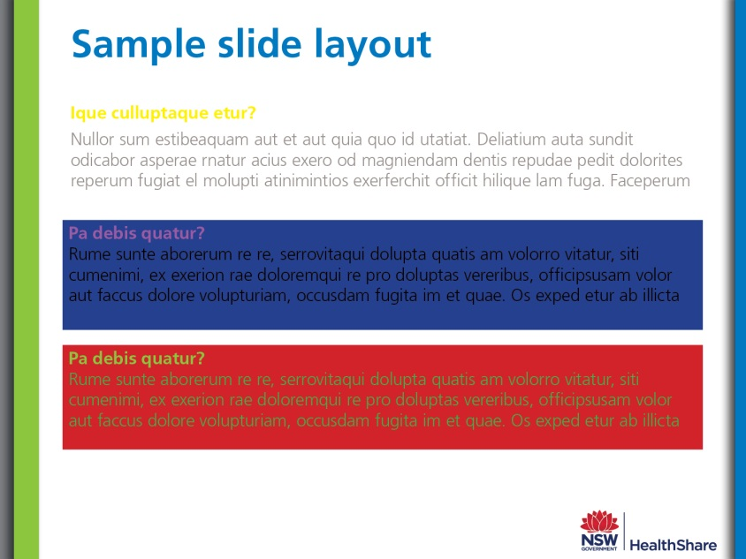
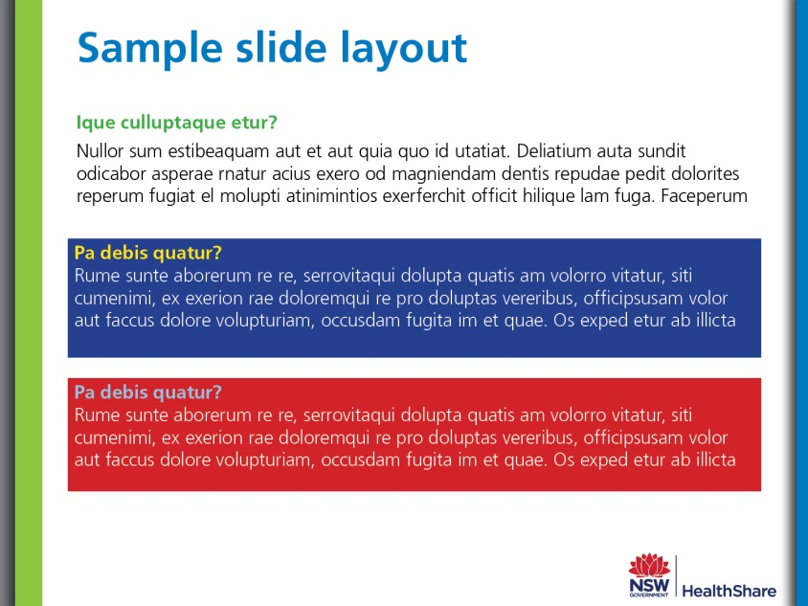
Ensure colour is high contrast
You will often be presenting in a darkened room, which affects visibility. Ensure that your colour choice is high contrast – i.e., dark text on light backgrounds or vice versa.
It’s best to keep body text as either black or white, and use colour to highlight headings. Avoid using red and green together, as people with colour blindness or poor visibility will have trouble reading it.
NO
YES

Slide 10

Choosing a font
Small fonts are hard to read, even when projected on a wall. Make it easy for your audience – don’t have your font size below 14pt and leave white space between each dot point. Bolding small fonts also often assists with readability.
Font choice helps create a mood: If you want to use a ‘fancy’ font save it for the headings and use a standard sans serif for the text. Sans serif fonts are generally easier to ready on screens, while serif fonts are more legible in printed documents.
Serif fonts have small lines at the ends of letters. Examples: Times New Roman, Palatino.
Sans Serif fonts have the decorative lines removed. Examples: Helvetica, Arial.
Slab Serif fonts have geometric serifs, and are good for headings. Examples: Rockwell, Courier.
Casual San Serif fonts should NEVER be used for professional/corporate documents. Examples: Comic Sans

Slide 11
Final tips before presenting
Avoid excessive use of slide transitions and video/audio files: as these can make your presentation slow to load and look unprofessional. Use video/audio files only if they are essential to your presentation.
Check spelling and grammar: make sure all your slides are correct and that all acronyms have been explained at least once (usually in the first instance).
Check the Slide Sorter: The slide sorter lets you see all your slides at once. Check that your slides are evenly balanced across your whole presentation, that chunks of text are broken up with images, and that nothing seems out of place.
Pretend you are the audience: or at least get someone unfamiliar with your presentation subject to look at it and evaluate it critically to ensure your audience will be able to understand your presentation. If possible, do a test run on a projector to ensure the font size is legible.
Providing handouts: If you want to provide your audience with handouts of your presentation, the easiest way is to insert your extra text or information you wish to include (such as contact details) in the notes section, and print out your presentation on the ‘Notes Pages’ setting.

Slide 12
Saving your presentation
Saving presentations to share: Save your presentation as PPS (PowerPoint Show) format rather than the standard PPT. This will lock your presentation and stop it being editable.
If using video/audio files: make sure these files accompany the PPS when sending – these don’t get embedded in the presentation in this format.
Saving infographics as images: If you want to use your infographic (or any of the slides) as an image in a report or other documentation, save the PowerPoint slide as a png file. Go to File: Save As: PNG
Saving your presentation as a video: PowerPoint 2010 presentations can be saved as videos. File: Save And Send: Create a video. For a video suitable
for the web, choose the ‘Portable Devices’ option.
You can add your own audio narration to your presentation prior to saving as a video, but your computer will need to be equipped with a sound card, speakers and microphone. To record, choose Slide Show: Record Slide Show. To end the recording, right-click the slide and select ‘End Show’.

